Slide 1
Variables

Slide 2
Creating a Variable
Assigning values to Variables
Reserve some space in memory.
Variable can store different data types.
= is used to assign values to variables.
The value that is stored in a variable can be changed.

Slide 3
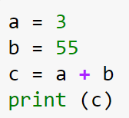
Variable Name | Value
a | 3
b | 55
c | 58

Slide 4
Variable Names
Are case sensitive!!! ( myVariable, myvariable,Myvariable)
Should start with lowercase letter.
Can include numbers, but not at the beginning (var8)
Can include underscores ( _ ), but not at the beginning / end ( my_variable )
Cannot
Begin with a digit
Contain any special characters

Slide 5
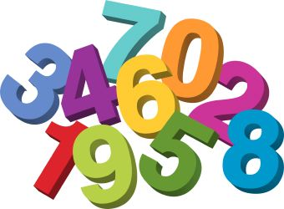

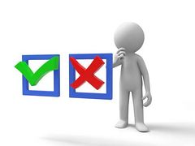
Variable Types
- integer: 3 , 40 , 500
- float / double: 3.45 , 7.2
- string: 'Hello world!'
- boolean: True , False
- null: None
- tuple, is a sequence of immutable objects
- lists, contains items separated by commas
and enclosed within square brackets

Slide 6
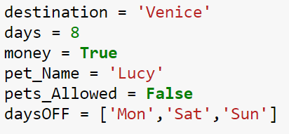


Slide 7
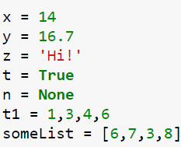


Run the program. Why does nothing happen?

Slide 8

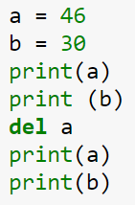
Delete a variable
a | 46
b | 30

Slide 9

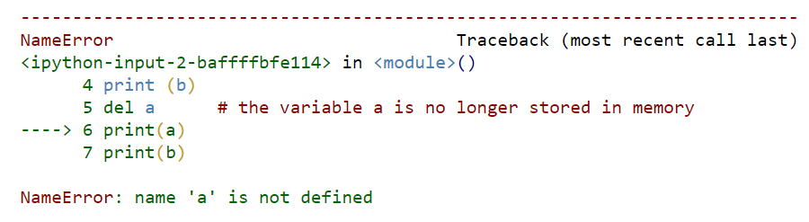
Output:

Slide 10
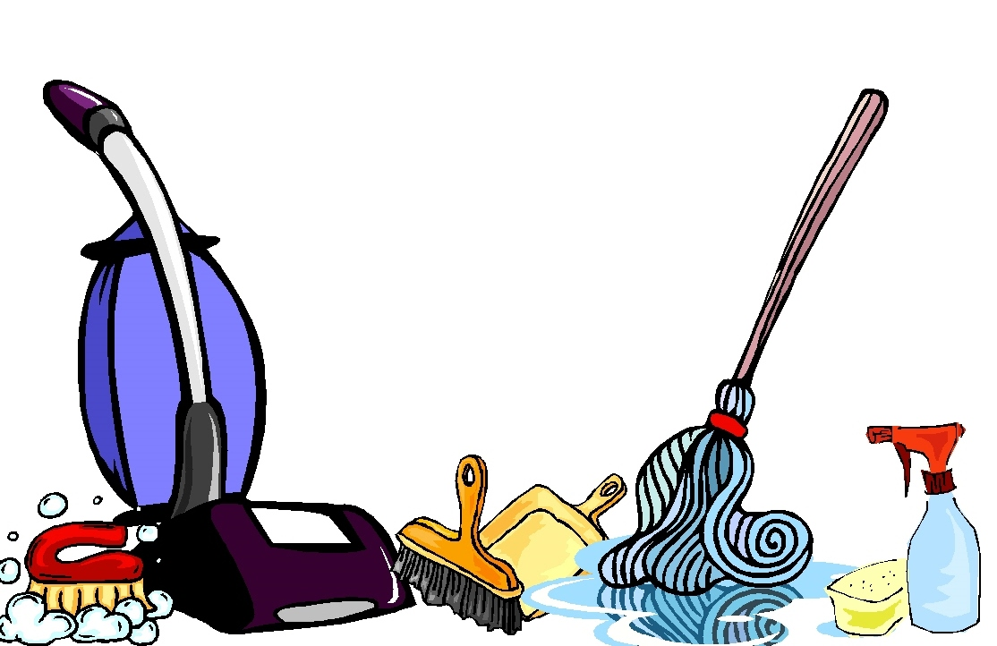
% reset
Cleans your namespace.
Deletes all the variables stored in memory.

Slide 11

Why variables?
They can be used when the value that they represent is unknown when the code is written.
They can save time when updating a script.
Cleaner code.

Slide 12
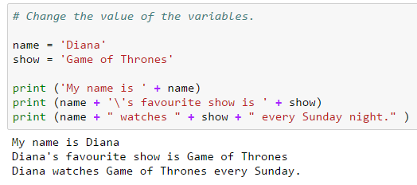

Change the value of variable 'name' and 'show'. See the problem? Not every show plays on Sunday night. Try to fix this problem by creating another variable.

Slide 13

User Input
Sometimes, values that are stored in variables need to be given by the user, not the programmer.

Slide 14
Strings
Are continuous set of characters represented in quotation marks.
Each character has its own position number called index.
Remember! The index number starts at 0 !!
‘C | O | M | P | U | T | E | R’
0 | 1 | 2 | 3 | 4 | 5 | 6 | 7
index
‘I |  | l | o | v | e |  | c | a | t | s’
0 | 1 | 2 | 3 | 4 | 5 | 6 | 7 | 8 | 9 | 10
index

Slide 15
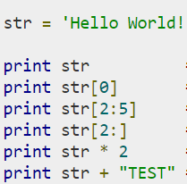
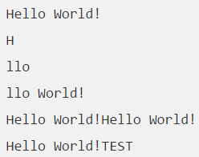
Subset of Strings ( [ ] and [ : ] )
Concatenation / Union ( + )
Repetition ( * )

Slide 16

Write a program that asks the user for a string and it prints out what the first letter of the word is.

Slide 17
2. Write a program that asks the user for a string and it prints out what the third letter of the word is.

Slide 18

a = len(string_name)
3. Write a program that asks the user for a string and it prints out the last letter of the string.

